Slide 1
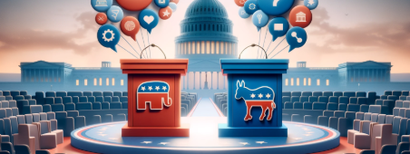
Twitter Analysis of the Harris-Trump Debate
Group 4
Gian, Pranav, Christopher, Srilekha

Slide 2


Understanding the Influence of Social Media on Public Sentiment During Political Events
Examining Twitter Reactions to the 2024 Presidential Debate
PROBLEM
STATEMENT
The goal of this analysis is to understand how public sentiment on social media shifts over time in response to key political events, particularly debates.
This includes identifying fluctuations in positive, negative, and neutral sentiment towards political figures before, during, and after the debate.
Online discourse can be shaped by the rhetoric of candidates and their supporters, which may lead to heightened polarization and increased hostility.
KEY
QUESTIONS
What are the dominant public sentiment trends on Twitter regarding each candidate?
Which political figure receives more positive or negative engagement during the debate?
How does the level of public interaction (likes, retweets, replies) correlate with sentiment trends?

Slide 3
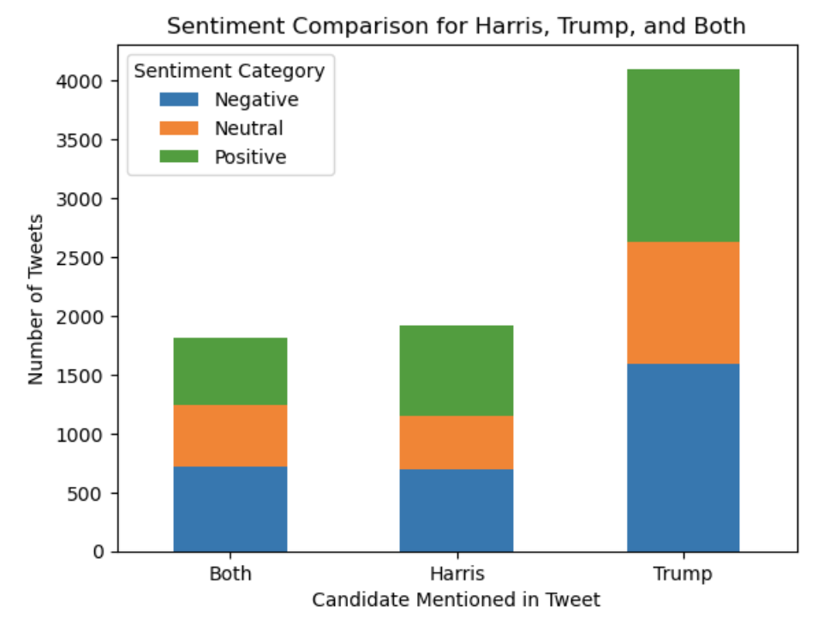
Analysis Steps: Data Cleaning, Transformation & Sentiment Analysis
STEPS
1
Data Cleaning & Preparation
Removed special characters, links, and stop words.
Standardized text format (lowercase, tokenization).
Sentiment Classification
Used VADER for sentiment scoring.
Categorized tweets as Positive (> 0.05), Neutral (-0.05 to 0.05), Negative (< -0.05).
Candidate-Based Sentiment Distribution: Bar chart comparing sentiment across Harris, Trump, and Both.
Key Findings:
- Trump had a higher tweet volume.
- Most tweets were neutral or negative.
4. Model Validation & AI Support
Applied TextBlob for secondary sentiment verification.
Used ChatGPT for debugging and refining analysis.
Data Source: Tweets taken from X (Twitter)

Slide 4
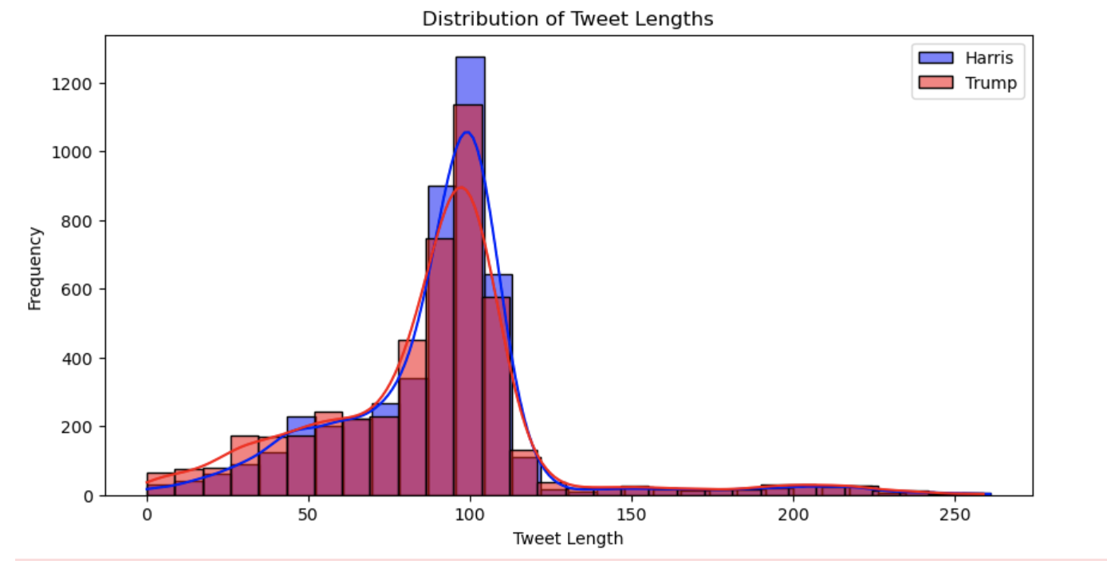
Understanding Tweet Length Distribution & Its Impact on Sentiment
Average tweet length varies between Trump & Harris discussions.
Longer tweets may indicate more complex opinions, while shorter ones may show strong sentiment.
Helps validate dataset quality before deeper sentiment analysis.
Data Source: Tweets taken from X (Twitter)

Slide 5
Data Treatment – Cleaning, Normalizing & Filtering Tweets
1. Merging Datasets
Loaded and examined Trump and Harris datasets to ensure data integrity, and checked for missing values and inconsistencies before merging.
Standardized column names across both datasets for seamless integration, merged datasets into a unified dataframe for further processing.
Created a 'candidate' column to differentiate tweets mentioning Trump, Harris, or both.
2. Cleaning Tweet Text
Removed redundant and irrelevant data to focus on sentiment-bearing content. Applied the following cleaning steps:
Retweets (RTs) removed to eliminate repeated data points.
Mentions (@usernames) excluded to focus on independent opinions.
Hyperlinks (URLs) filtered out as they don’t contribute to sentiment.
Punctuation, special characters, and symbols deleted to standardize formatting.
Hashtags eliminated to avoid skewing analysis with metadata.
Duplicate tweets dropped to prevent duplicate impact on sentiment trends.
Emojis converted or removed based on sentiment analysis feasibility..
3. Normalizing Text
Standardized textual structure for uniform processing.
Key normalization techniques applied:
Converted all text to lowercase to ensure case-insensitive processing.
Tokenized text by splitting sentences into individual words.
Applied lemmatization to reduce words to their base/root forms.
Removed stop words such as "and," "the," "is" to retain meaningful words.
Corrected spelling errors and abbreviations for text integrity.
4. Filtering Tweets
Refined dataset to focus on relevant political discourse.
Implemented tweet categorization based on candidate mentions:
Harris-only tweets (containing only 'Harris')
Trump-only tweets (containing only 'Trump')
Both candidates mentioned (referencing both Trump and Harris)
User-based aggregation applied: Identified users tweeting multiple times to track sentiment evolution. Grouped tweets by user ID to observe engagement trends.
Merging Datasets Together: Combined datasets to simplify data processing, ensuring all relevant information is efficiently in one place
Filtering Text: Filtered and grouped tweets based on specific criteria (e.g., keywords like "Trump" or "Harris"), and categorized users' tweets with opposing views into separate groups for analysis
Data Source: Tweets taken from X (Twitter)

Slide 6
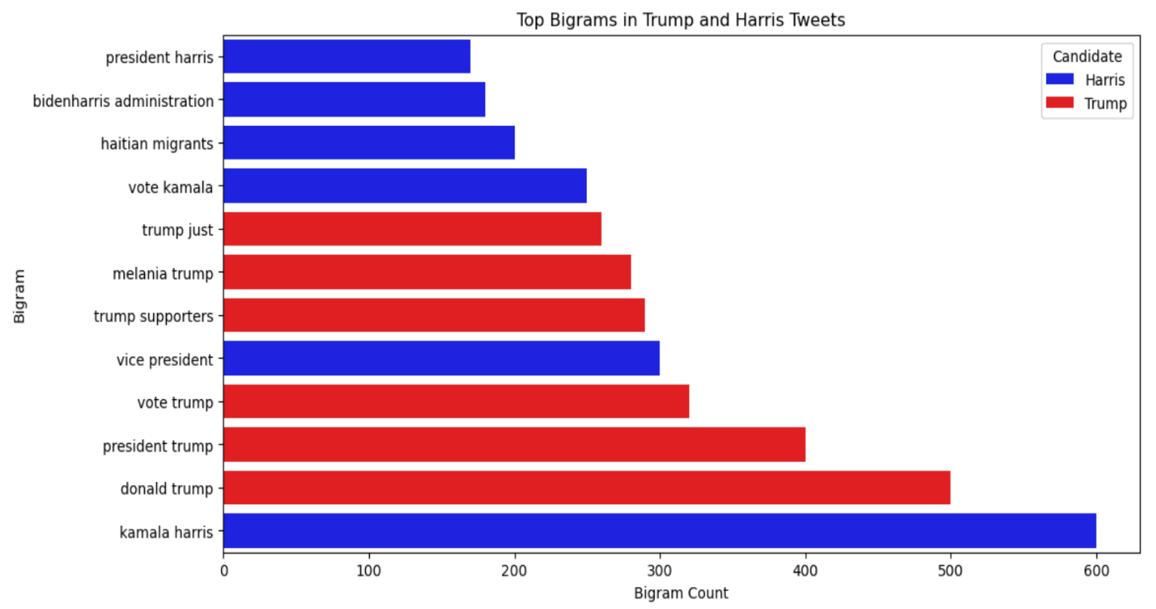
Sentiment Distribution & Key Themes in Debate Tweets
Bigram Analysis
Harris
Discussion centers around policy & governance, with bigrams like “Vice President”, “vote Kamala”, and “BidenHarris administration”.
Immigration-related discourse emerges with terms like “Haitian migrants”, indicating a policy-oriented conversation.
Lower emotional language, reflecting a more structured and issue-based engagement.
Trump
Tweets have a mix of political & personal references, with bigrams like “Trump supporters” and “Melania Trump”.
Stronger election focus seen through terms like “vote Trump” and “president Trump”.
More polarized discourse, with terms reflecting support and criticism, leading to a highly reactive engagement pattern.
Key Difference
Harris’s discussions lean towards policy & governance, whereas Trump’s discussions are more personality-driven and polarized.
Harris's name appears alongside administration and campaign themes, while Trump’s name is more connected with his supporters and direct election discourse.
Data Source: Tweets taken from X (Twitter)

Slide 7
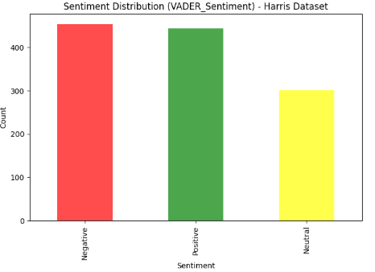
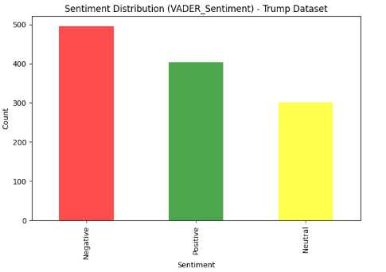
Sentiment Analysis: Vader
VADER (Valence Aware Dictionary and Sentiment Reasoner) is a sentiment analysis tool specifically designed to work with short text, such as tweets, reviews, and social media comments.
✅ Fast & Lightweight – Works in real-time applications ✅ Understands Social Media Language – Detects slang, emojis, capitalization, and punctuation ✅ Handles Negation & Intensifiers – Recognizes phrases like "not great" or "very good" ✅ Best used cases: Social Media, customer reviews, brand monitoring and New & Political Sentiment
Data Source: Tweets taken from X (Twitter)

Slide 8
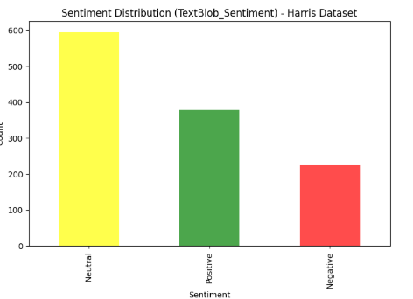
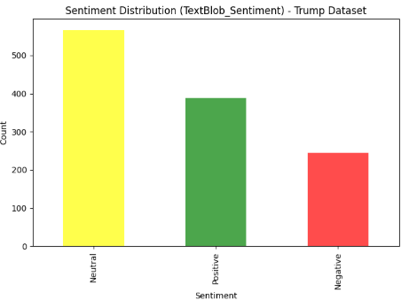
Sentiment Analysis: TextBLOB
TextBlob – is a simple and easy-to-use NLP library for sentiment analysis, text classification, and language processing.
✅ Lexicon-based Sentiment Analysis – Uses a predefined word polarity dictionary ✅ Supports Text Processing – Tokenization, POS tagging, and noun phrase extraction ✅ Handles Subjectivity & Polarity – Measures both sentiment intensity and opinion strength ✅ Best Used Cases: Opinion-based Content, Article, Blogs and Academic & Formal Text Analysis
Data Source: Tweets taken from X (Twitter)

Slide 9
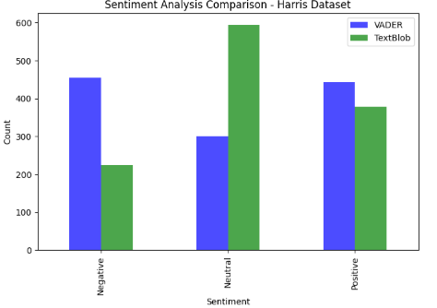
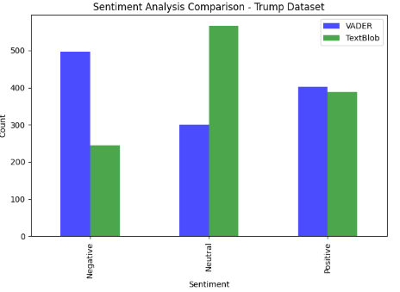
Sentiment Analysis: VADER vs TEXTBLOB
Vader vs TextBlob: Why VADER Shows More Negativity & TextBlob More Neutrality?
VADER handles negation, intensifiers, emojis, and punctuation, making it more sensitive to extreme sentiment, while TextBlob is lexicon-based and more balanced.
VADER is best for short, informal text (e.g., tweets, chat messages, reviews) because it understands slang, emojis, negation, and intensity.
TextBlob is better for long-form, formal text (e.g., news articles, product reviews) but lacks negation handling and intensity awareness.
Data Source: Tweets taken from X (Twitter)

Slide 10
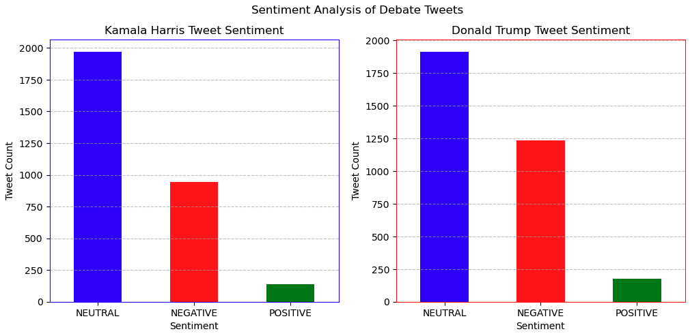
Sentiment Analysis: Hugging Face’s BERT Model
Sentiment Analysis Using Hugging Face’s BERT Model
Sentiment Analysis Findings: Tweets about Kamala Harris and Donald Trump showed distinct sentiment distributions, with noticeable differences in positive, neutral, and negative classifications.
Comparison Insights: One candidate had a higher proportion of negative tweets, potentially influenced by public perception or debate controversies, while the other had more neutral sentiment.
Limitations & Future Scope: The model may have missed nuanced expressions like sarcasm, and future improvements could involve fine-tuning for political discourse analysis.
Data Source: Tweets taken from X (Twitter)

Slide 11
Packages used for the analysis
PACKAGE
USE CASE
PACKAGE
USE CASE
nltk.sentiment.SentimentIntensityAnalyzer
VADER sentiment analyzer for determining Positive, Negative, and Neutral scores
Pandas
Used for data manipulation
Matplotlib.pyplot
transformers
Utilized to load Hugging Face’s RoBERTa model for sentiment classification.
Used for data visualization
Re
Helps in text cleaning
emoji
Extracting and processing emojis in tweets
NLTK
Provides text-processing tools
langdetect
Detecting the language of tweets before analysis
textblob.TextBlob
Sentiment analysis tool that provides polarity
nltk.corpus
Accessing pre-built NLP datasets (e.g., stopwords).

Slide 12
Challenges Encountered During the analysis
Challenges
Data Collection & Quality Issues
Difficulty in filtering out bots or spam accounts that could skew sentiment trends.
Presence of noisy data such as irrelevant tweets, typos, and sarcasm that are hard to interpret accurately.
Sentiment Analysis Limitations
VADER Challenges: Over-sensitivity to punctuation, emojis, and capitalization, which may exaggerate sentiment scores.
TextBlob Challenges: Less effective with short, informal text like tweets; struggles with negation and intensity modifiers.
Bias in Sentiment Tools
Lexicon-based models may not capture nuanced political language or cultural context.
Potential bias in sentiment scoring due to pre-defined dictionaries not accounting for evolving slang or political terms.
Polarization in Discourse
Highly polarized language (e.g., strong support or criticism) made it difficult to classify tweets as purely positive or negative.
Neutral tweets often contained mixed sentiments, complicating classification.
Data Source: Tweets taken from X (Twitter)

Slide 13
Conclusion
Dominant Public Sentiment Trends on Twitter
Kamala Harris: Sentiment was largely neutral to positive, focusing on policy and governance (e.g., “Vice President,” “BidenHarris administration”). Discussions were structured and less emotionally reactive.
Donald Trump: Sentiment was highly polarized, with a mix of negative and positive tweets. Discourse often included personal references and election-focused terms (e.g., “vote Trump,” “Trump supporters”).
Positive vs. Negative Engagement
Donald Trump: Higher tweet volume but predominantly neutral or negative sentiment, reflecting polarized reactions.
Kamala Harris: Fewer tweets overall but a higher proportion of positive sentiment, with engagement centered on policy-driven discussions.
Correlation Between Public Interaction and Sentiment
Tweets with positive sentiment for both candidates attracted more likes and retweets, indicating audience resonance with favorable messages.
For Trump, negative tweets also saw significant replies, reflecting polarization and debate-driven reactions.
Harris's neutral or policy-focused tweets had moderate engagement, highlighting an issue-driven audience
Data Source: Tweets taken from X (Twitter)

